Slide 1
Implementation
Notes:
Moving on to implementation of our models

Slide 2
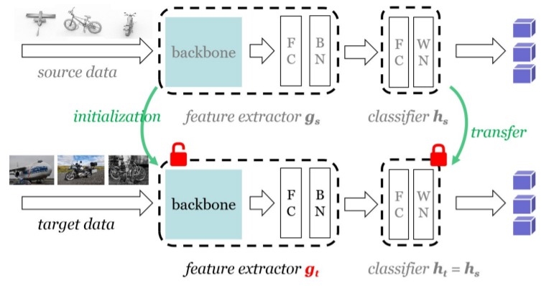
SHOT
Learns target feature extractor, g_{t}, with a fixed source classifier, h_{s}
Exact same classifier, h_{s}, is used to classify images from target domain
Literature Review | Methodology | Implementation | Results | Discussion
Notes:
We start with the source hypothesis transfer algorithm. For the model to be capable of learning expressive representations on complex visual input, the models used in SHOT utilise a Res net 101 as the backbone architecture.
We first train the model to minimise the cross-entropy loss on source domain data. Once learnt, we freeze the topmost source classifier module, h s, as this encodes information about unseen data in the source domain. This classifier module will then later used to classify input images from the target domain as well.

Slide 3
SHOT
Learns target feature extractor, g_{t}, with a fixed source classifier, h_{s}
Exact same classifier, h_{s}, is used to classify images from target domain
Objective is to learn g_{t}, that is capable of extracting features from target domain input with similar distributions to those produced by g_{s}.
Literature Review | Methodology | Implementation | Results | Discussion
Notes:
Hence, SHOT minimises the Information Maximisation Loss and employs self pseudo-labelling in order to train the network to extract features, with the feature extractor, g s, that have similar distributions to source domain features from target domain data, enabling the source domain trained classifier to be able to classify images from the target domain as well.

Slide 4
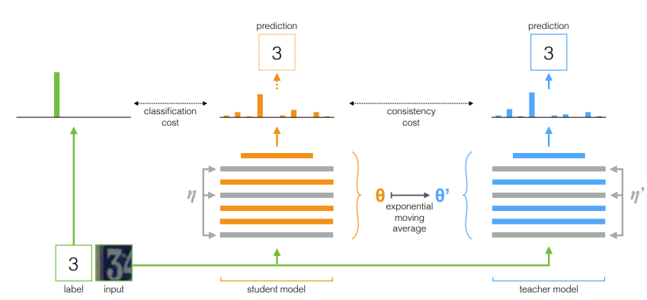
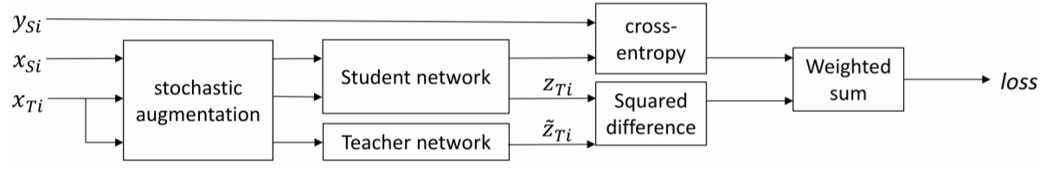
Mean-Teacher
Semi-Supervised Learning
Adapted for
Domain Adaptation
Student trained via typical supervised learning on labelled data. Teacher is EMA of student. Consistency loss between networks
Similar architecture. Source and domain data fed in through 2 separate streams. Minimise weighted sum of classification and similarity losses
Literature Review | Methodology | Implementation | Results | Discussion
Notes:
Our next method is self-ensembling for visual domain adaptation, also termed mean-teacher. The key idea is that student network first minimises the cross-entropy loss when classifying labelled images. The teacher network is an exponential moving average of the student network, which is fed in images from the target domain. The student network then ultimately minimises a weighted sum of the cross-entropy loss and squared difference between its output and the teacher network’s output.

Slide 5
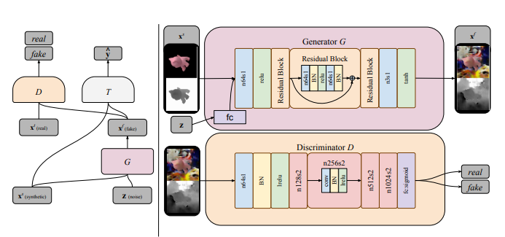
Pixel Domain Adaptation
Adversarial network and a classifier network.
Source images translated to target domain to trick discriminator
Classifier trained on generated fake images
Literature Review | Methodology | Implementation | Results | Discussion
Notes:
Pixel domain adaptation performs pixel level transformation from one domain to another, adapting source-domain images to appear as if they were drawn from the target domain. It decouples the process of domain adaptation from the task-specific classification, such that any off-the-shelf classifier can be trained on the resultant dataset without having to perform domain adaptation. This is done by training the classifier with the translated images produced by the generator from the adversarial network.

Slide 6
Pixel Domain Adaptation
Adversarial network and a classifier network.
Source images translated to target domain to trick discriminator
Classifier trained on generated fake images
Adam Optimizer, learning rate 0.0002
Mean Squared error , and categorical cross entropy loss function
Accuracy Metrics
Literature Review | Methodology | Implementation | Results | Discussion
Notes:
We used an Adam optimizer, mean squared error and categorical cross entropy loss function, and accuracy metrics.

Slide 7
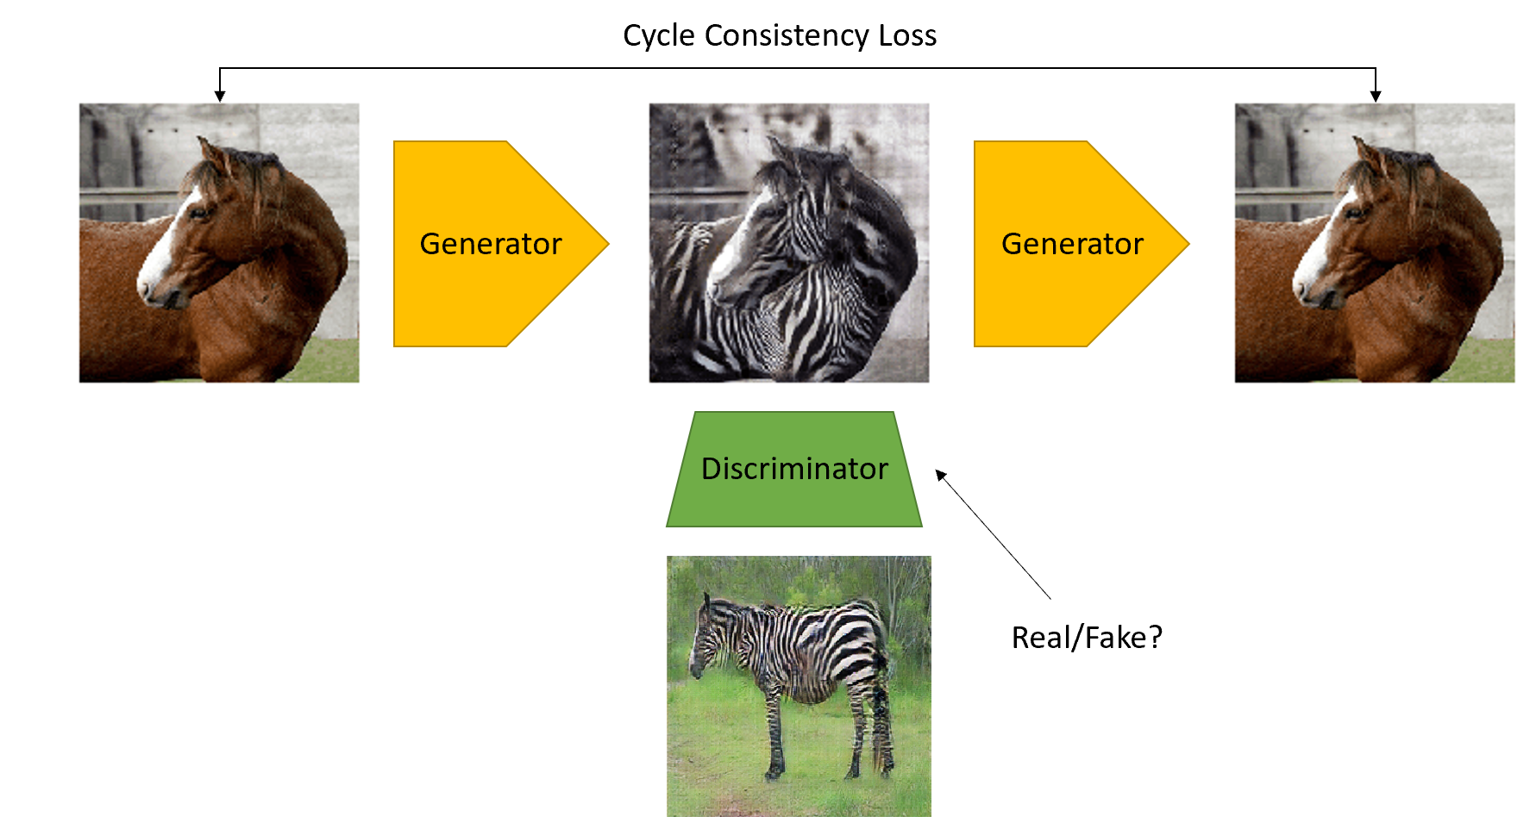
CyCLEGAN
Unsupervised Learning – Unpaired image-image translation
1st Generator translates source images to look like images from target domain
2nd Generator translates generated image to look like the original image again
Discriminator detects if image is generated (fake) or original (real)
Literature Review | Methodology | Implementation | Results | Discussion
Notes:
Cycle GAN is a generative adversarial network that uses 2 unpaired datasets for image translation. Cycle GAN consists of 1 generator to translate the image of one domain to look like the images from the other domain, and a second generator to translate the image back to look like its original image before the first translation. The discriminator in the model is trained to detect if the image is a real original image from the dataset or a generated fake image.

Slide 8
CyCLEGAN
Unsupervised Learning – Unpaired image-image translation
1st Generator translates source images to look like images from target domain
2nd Generator translates generated image to look like the original image again
Discriminator detects if image is generated (fake) or original (real)
Cycle consistency loss calculates difference between source image and 2nd generated image to improve generator
Image Classifier trained with generated image as the dataset
Literature Review | Methodology | Implementation | Results | Discussion
Notes:
Cycle GAN uses the concept of cycle consistency loss, which is the calculated difference between the input photo and the second generated photo, to improve the generator in translating the image.

Slide 9
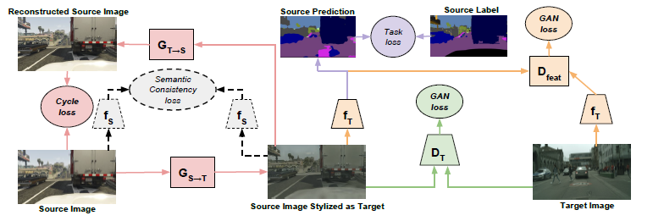
Cycada
Cycle-Consistent Adversarial Domain Adaptation
Builds upon cycle-consistency from CycleGAN
Adds feature adapt after to enforce semantic consistency
Combining the interpretability and low level structural consistency of prior image-level approaches with regularisation and strong empirical performance of prior feature-level approaches.
Literature Review | Methodology | Implementation | Results | Discussion
Notes:
Cyca da builds upon the cycle consistency offered by Cyca da , adding an additional layer of feature adaptation. This enforces semantic consistency, and allows the model to combine the interpretability and low-level structural consistency of prior image level approaches with regularisation and strong empirical performance of feature-level approaches.

Slide 10
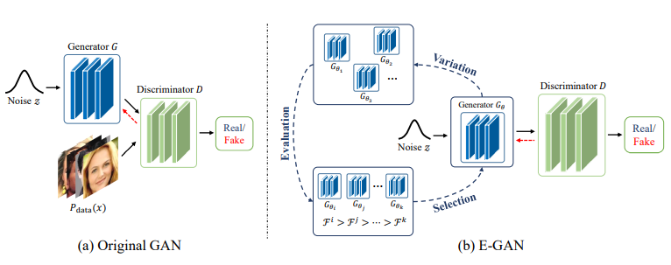
Novel Approach – Cycle-EGAN
Extends CycleGAN – Cycle Consistency Loss is Promising
Cycle-Consistent Adversarial Domain Adaptation
Evolutionary approach to fine-tune loss functions for discriminators and generators
Holds promise for being able to outperform baselines by preserving genetic pool of strong GANs
Literature Review | Methodology | Implementation | Results | Discussion
Notes:
As will be discussed later, we found Cyca da to have the best performance, and hence extend it in our novel approach. Furthermore, we believe the cycle consistency loss to be important and promising. We employ evolutionary approaches to fine-tune the loss functions for discriminators and generators. We then choose which gans to keep in the genetic pool by comparing their performances with a fitness function.

Slide 11
Novel Approach – Cycle-EGAN
Extends CycleGAN – Cycle Consistency Loss is Promising
Cycle-Consistent Adversarial Domain Adaptation
Evolutionary approach to fine-tune loss functions for discriminators and generators
Holds promise for being able to outperform baselines by preserving genetic pool of strong GANs
Computationally Expensive – Many GANs to train
Literature Review | Methodology | Implementation | Results | Discussion
Notes:
While we believe this approach to be promising means to search the space of loss functions, it is unfortunately very computationally expensive since we would have to train many different gans.

Slide 12
Results
Notes:
Let’s discuss the experimental results.

Slide 13
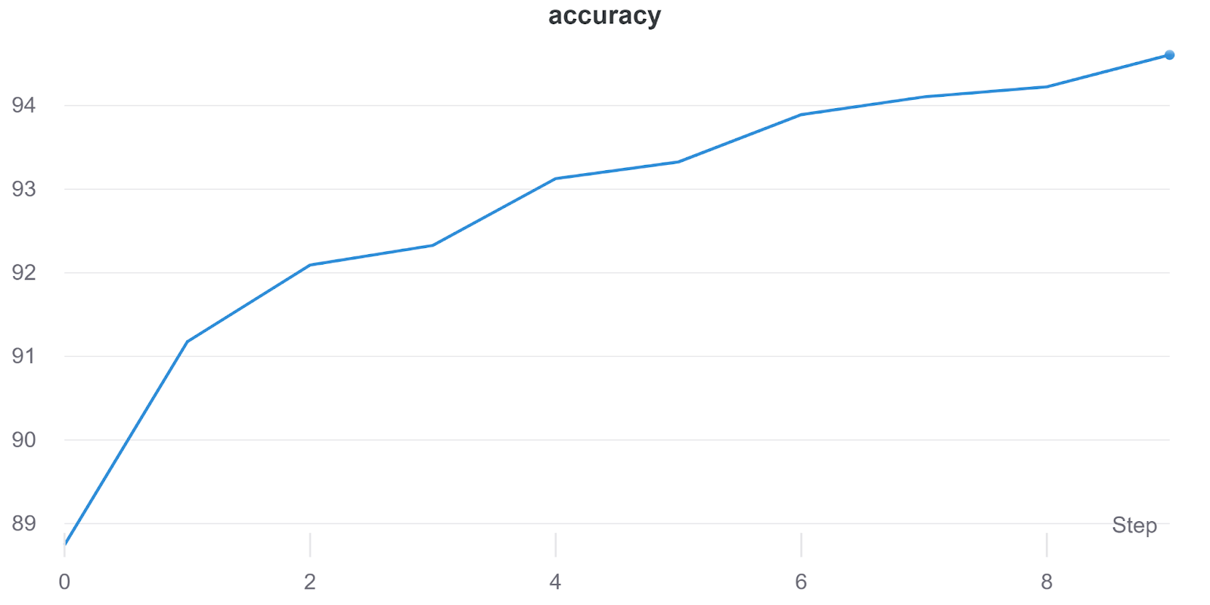
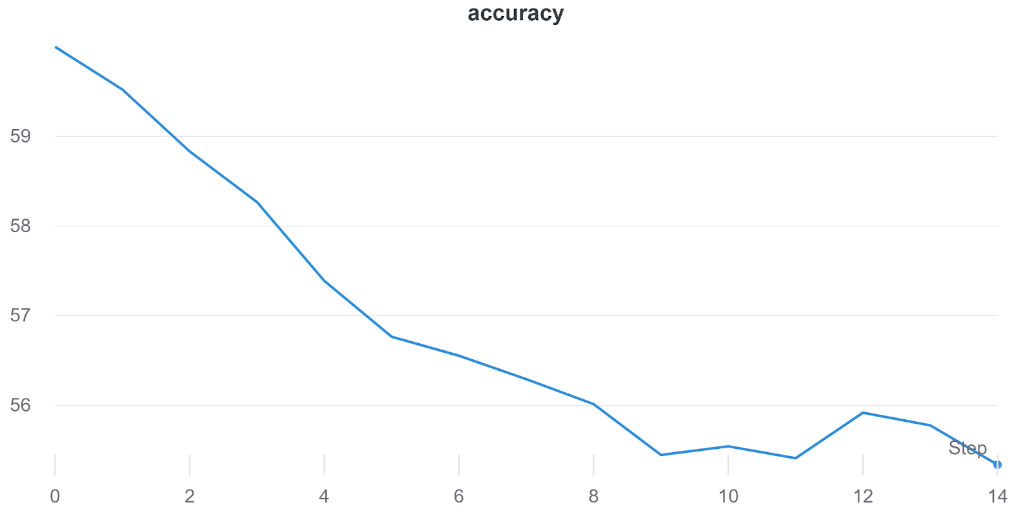
SHOT
Training on Source
Training on Target
Good performance when training classifier on source domain with Resnet101 backbone
Deteriorating performance when training target domain feature extractor, g_{t}
Literature Review | Methodology | Implementation | Results | Discussion
Notes:
As the first step of the procedure, we first train the source classifier on source domain images. We can obtain good classification accuracy in the source domain. However, when we attempted to train the target domain feature extractor, we encountered degrading performance as training progressed. While we initially hypothesized that the presence of an “others” class could be responsible, we eventually found that performance was also poor when trained on the Visda 17 dataset, which did not have this class.

Slide 14
Mean-Teacher
Trained for 3 epochs over 8 hours on K80 GPU
Resnet152 backbone
Classification accuracies in % reported
Epochs | Aeropl-ane | Bicycle | Bus | Car | Horse | Knife | Motor-cycle | Person | Plant | Skateb-oard | Train | Truck | Other | Mean
1 | 0.00 | 83.86 | 0.00 | 60.19 | 46.70 | 0.00 | 0.17 | 39.50 | 25.78 | 0.00 | 0.00 | 0.00 | 86.37 | 26.35
2 | 69.23 | 85.59 | 60.77 | 70.19 | 64.82 | 0.00 | 81.69 | 55.50 | 69.16 | 0.00 | 19.62 | 23.11 | 72.40 | 51.70
3 | 78.85 | 84.44 | 78.89 | 68.27 | 68.87 | 0.97 | 84.11 | 58.00 | 70.71 | 15.79 | 43.50 | 23.11 | 67.03 | 57.12
Managed to obtain reasonably good performance
Accuracies improved in general across the 3 epochs
Accuracy on “others” decreased – Original high accuracy could be due to guessing
Literature Review | Methodology | Implementation | Results | Discussion
Notes:
On the other hand, we were able to obtain fairly good performance with the mean-teacher model. Utilising a Res net 152 backbone, we trained the network for 8 hours on a K80 GPU, and were able to complete 3 epochs of training. Results were promising and we should have been able to obtain better performance should we have had more computational resources. Of note, accuracy in the “others” class decreased. We expect that the initial strong performance was probably more so due to random guessing from the network.

Slide 15
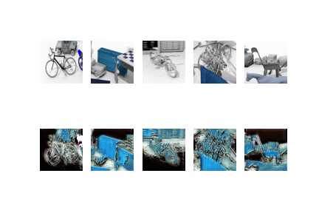
Pixel Domain Adaptation
Original
30000 Epochs and 16 batch size
Took roughly 3 hours to complete
Classifier had an average of 72% classification accuracy
Performed faster and better
Generated
Literature Review | Methodology | Implementation | Results | Discussion
Notes:
The model was trained on 30000 epochs with a batch size of 16. The training was done after roughly 3 hours. The resultant classifier had an average classification accuracy of about 72 percent on the last 100 epochs, when tested on the target domain images.
The original images and the translated images can be seen on the right hand side of the slide, with the original images being on the top row and the translated images on the bottom row. These sample images was taken from the model after 30000 epochs. Pixel domain adaptation seemed to perform faster and better generally than the other models. With a shorter training time and a higher classification accuracy.

Slide 16
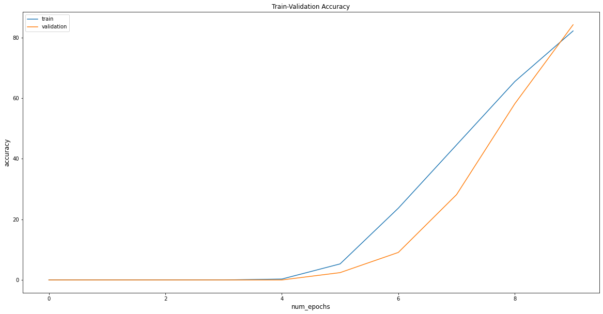
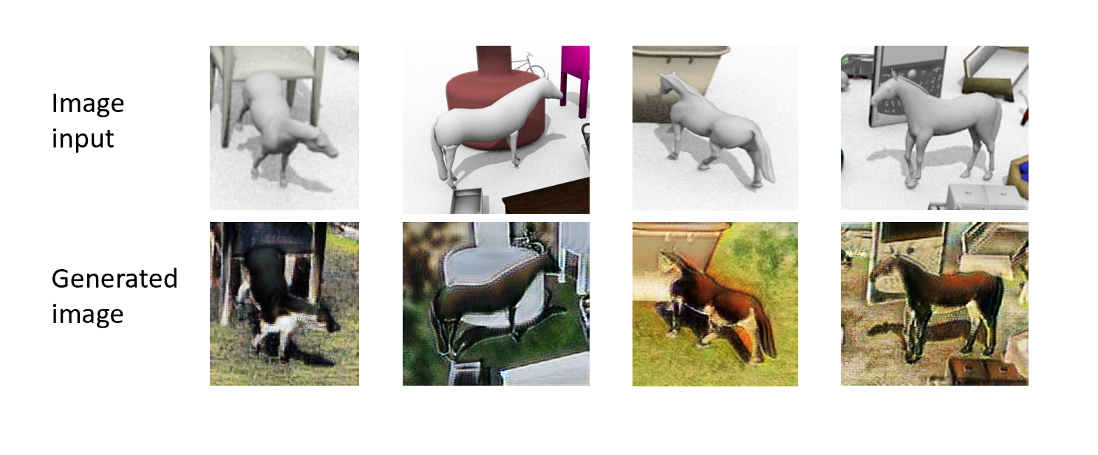
CyCLEgan
Accuracy: 82% , 10 epochs
Literature Review | Methodology | Implementation | Results | Discussion
Notes:
The left side of the slide shows some synthetic horse images from the source domain that are translated using cycle gan. A total of 1000 translated horse images are generated as the training dataset to train the image classification res net 101 model. The Visda validation dataset is used for validation of the model. The right side of the slide shows the graph of the accuracy over 10 epochs for the generated horse dataset. The model has achieved a training classification accuracy of 82 percent after 10 epochs.

Slide 17
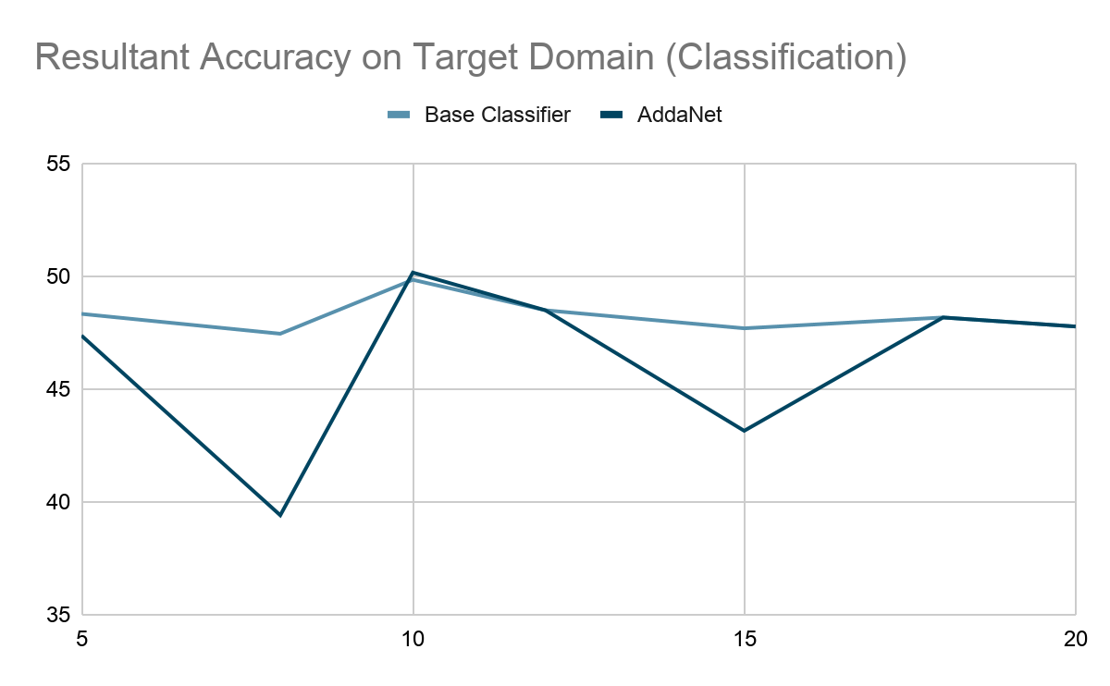
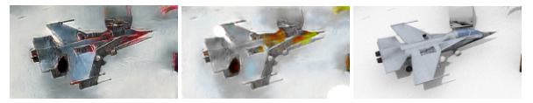
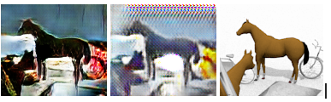
cycada
Notes:
On the left we see some images of synthetic aeroplanes and horses generated by cyca da. From left to right, the first image is the generated image, the second is the mapping of the generated image back to source and the last image is the source image. Using the generated images, we train the task classifier with feature adaptation. The results are shown on the right. Notably, training with feature adaptation only outperforms the base classifier at 10 epochs, and only by a marginal amount at 50.18 percent. This suggests that feature adaptation does not lend significant performance improvements for classification tasks.

